Slide 1
Python List
Common data structure in Python
A python list is like a C array but much more:
Dynamic (mutable): expands as new items are added
Heterogeneous: can hold objects of different types
How to access elements?
List_name[index]

Slide 2
Example
>>> t = [123, 3.0, ‘hello!’]
>>> print t[0]
123
>>> print t[1]
3.0
>>> print t[2]
hello!

Slide 3
Example – Merging Lists
>>> list1 = [1, 2, 3, 4]
>>> list2 = [5, 6, 7, 8]
>>> merged_list = list1 + list2
>>> print merged_list
Output: [1, 2, 3, 4, 5, 6, 7, 8]

Slide 4
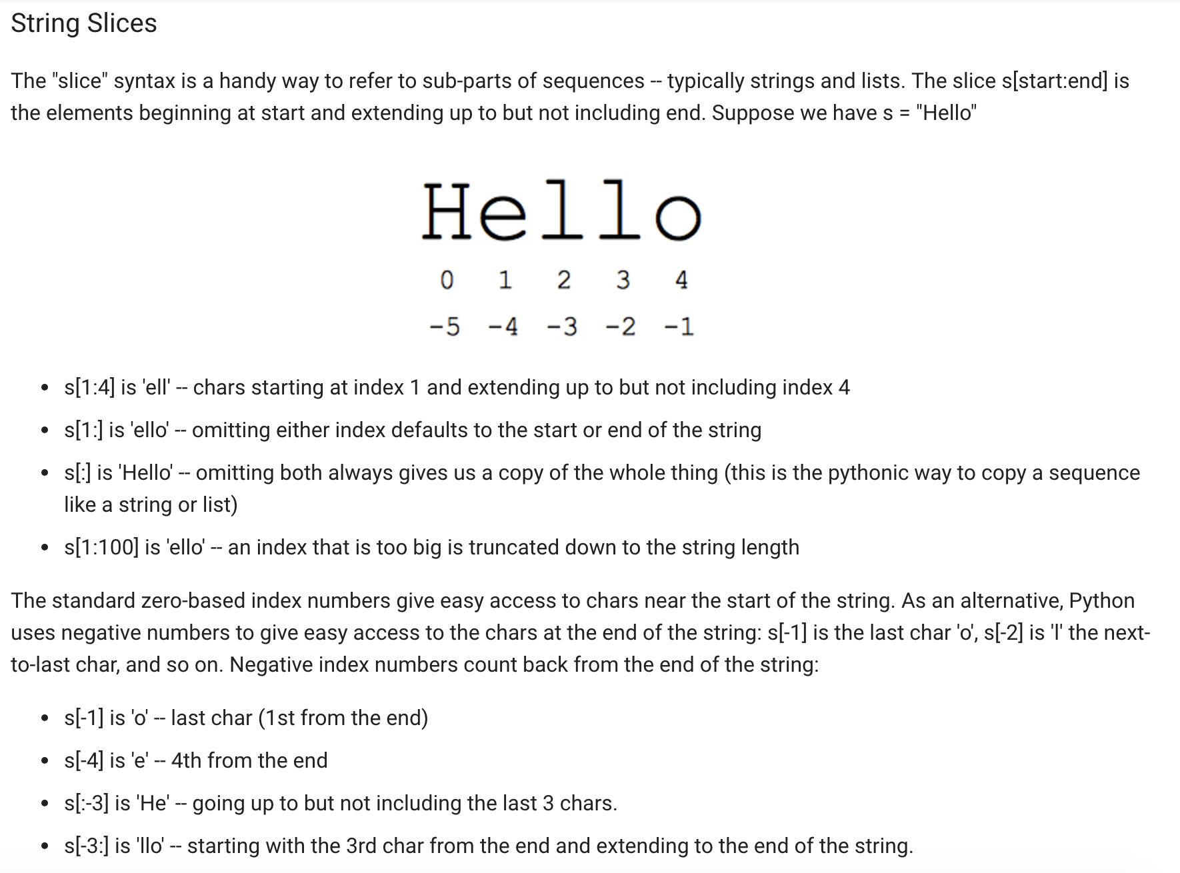

Slide 5
Python Dictionary
Essentially a hash table
Provides key-value (pair) storage capability
Instantiation:
dict = {}
This creates an EMPTY dictionary
Keys are unique, values are not!
Keys must be immutable (strings, numbers, tuples)

Slide 6
Example
dict = {}
dict[‘hello’] = “world”
print dict[‘hello’]
world
dict[‘power’] = 9001
if (dict[‘power’] > 9000):
print “It is over “, dict[‘power’]
It is over 9001
del dict[‘hello’]
del dict

Slide 7
for loops
list = [‘Mary’, ‘had’, ‘a’, ‘little’, ‘lamb’]
for i in list:
print i
Result:
Mary
had
a
little
lamb
for i in range(len(list)):
print i
Result:
0
1
2
3
4

Slide 8
Optparse Library
Powerful library for parsing command-line options
Argument:
String entered on the command line and passed in to the script
Elements of sys.argv[1:] (sys.argv[0] is the name of the program being executed)
Option: (like linux flags)
An argument that supplies extra information to customize the execution of a program
Option Argument:
An argument that follows an option and is closely associated with it. It is consumed from the argument list when the option is

Slide 9
I/O Basics
The raw_input([prompt]) function reads one line from standard input and returns it as a string (removing the trailing newline)
str = raw_input("Enter your input: ");
print "Received input is : ", str
The input([prompt]) function is equivalent to raw_input, except that it assumes the input is a valid Python expression and returns the evaluated result to you.
str = input("Enter your input: ");
Print "Received input is : ", str

Slide 10
Python split
Python split using delimiter:
>>> x = “blue, red, green”
>>> x.split(“,”) #”,” is a delimiter here
Output: [‘blue’, ‘red’, ‘green’]
>>> a, b, c = x.split(“,”)
>>> a
‘blue’
>>> b
‘red’
>>> c
‘green’

Slide 11
Task 2
Write a program that accepts sequence of newlines from the user as input till the user gets bored. (The user gets bored when he/she presses Enter twice)
Hint: to detect if Enter is pressed twice (in other terms - the user input is void)
Suppose your input string name is ‘s’ just type:
if s:
#write code to capitalize (s.upper()) this input string ‘s’ and append it to a ‘new_list’
Now, print all the elements of this ‘new_list’
Suppose the following input is supplied to the program:
Hello world
Practice makes perfect
Then, the output should be:
HELLO WORLD
PRACTICE MAKES PERFECT

Slide 12
Task 2 solution
new_list = []
while True:
s = input()
if s:
new_list.append(s.upper())
else:
break
for sentence in new_list:
print sentence

Slide 13
Task 3
Write a Python program to get a string made of the first 2 and the last 2 chars from a given a string.
Sample String : 'w3resource'
Expected Result : 'w3ce'
Sample String : 'w3'
Expected Result : 'w3w3'

Slide 14
Task 3 solution
string = "w3resource"
string1 = string[0:2]
string2 = string[-2:]
concat = string1+string2
print concat

Slide 15
Task 4
Create a python dictionary with the following keys and values:
“Names” : [“Mickey”, “Minnie”]
“Mickey” : [ “UCLA”, “Bachelor Degree”]
“Minnie” : [“UCB”, “Bachelor Degree”]
The values in the dictionary are in the form of a list.
D= {}
D[KeyName ] =Value
Now traverse the dictionary with the key as ‘Names’ and for every element in this list, find the corresponding key (eg. ‘Mickey’). Append the word “Computer Science” to the value (eg. the list of ‘Mickey’) of that particular key.
Now create a new key-value pair for “DonaldDuck” - [“Stanford”, “PhD”, “Computer Science”]. Add the name ‘DonaldDuck’ to the ‘Names’ list as well

Slide 16
Task 4 solution
d={}
d["Names"]=["Mickey", "Minnie"]
d["Mickey"]=["UCLA", "Masters"]
d["Minnie"]=["UCB", "Bachelors"]
for name in d["Names"]:
d[name].append("Computer Science")
d["DonaldDuck"]=["Stanford", "PhD", "Computer Science"]
d["Names"].append("DonaldDuck")
print d

Slide 17
Task 5
Sort a list in python
List1 = [12,232,2,4,4,45,4,5,1,100] #whatever elements you want to add
List.sort()
Sorted(list)

Slide 18
Task 5 solution
List1 = [12,232,2,4,4,45,4,5,1,100]
List1.sort() #saves a sorted list
sorted(List1) # outputs a sorted list but does not save the sorted list

Slide 19
Task 6
Write a factorial function which takes a number ‘n’ as input and prints/returns its factorial (don’t forget to call the function)
fact(5) = 120
Base case:
fact(1)=1
fact(0)=1
def fact(n):
#.....

Slide 20
Task 6 solution
def fact(n):
if n == 0:
return 1
else:
return n * fact(n-1)

Slide 21
Task 7
Reverse a given string

Slide 22
